Slide 1
Neural Networks with Google TensorFlow
Darshan Patel
Northeastern University

Slide 2
Neural Networks with Google TensorFlow
Overview:
Computer Vision Tasks
Convolution Neural Network (CNNs) Architecture
CNNs using Google TensorFlow
Google TensorBoard

Slide 3
Computer Vision
Tasks

Slide 4
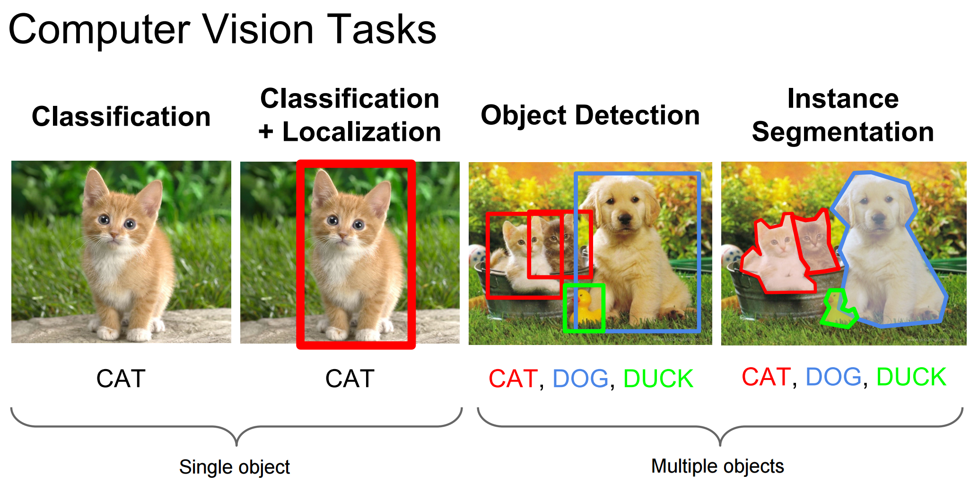
Source : http://cs231n.stanford.edu

Slide 5
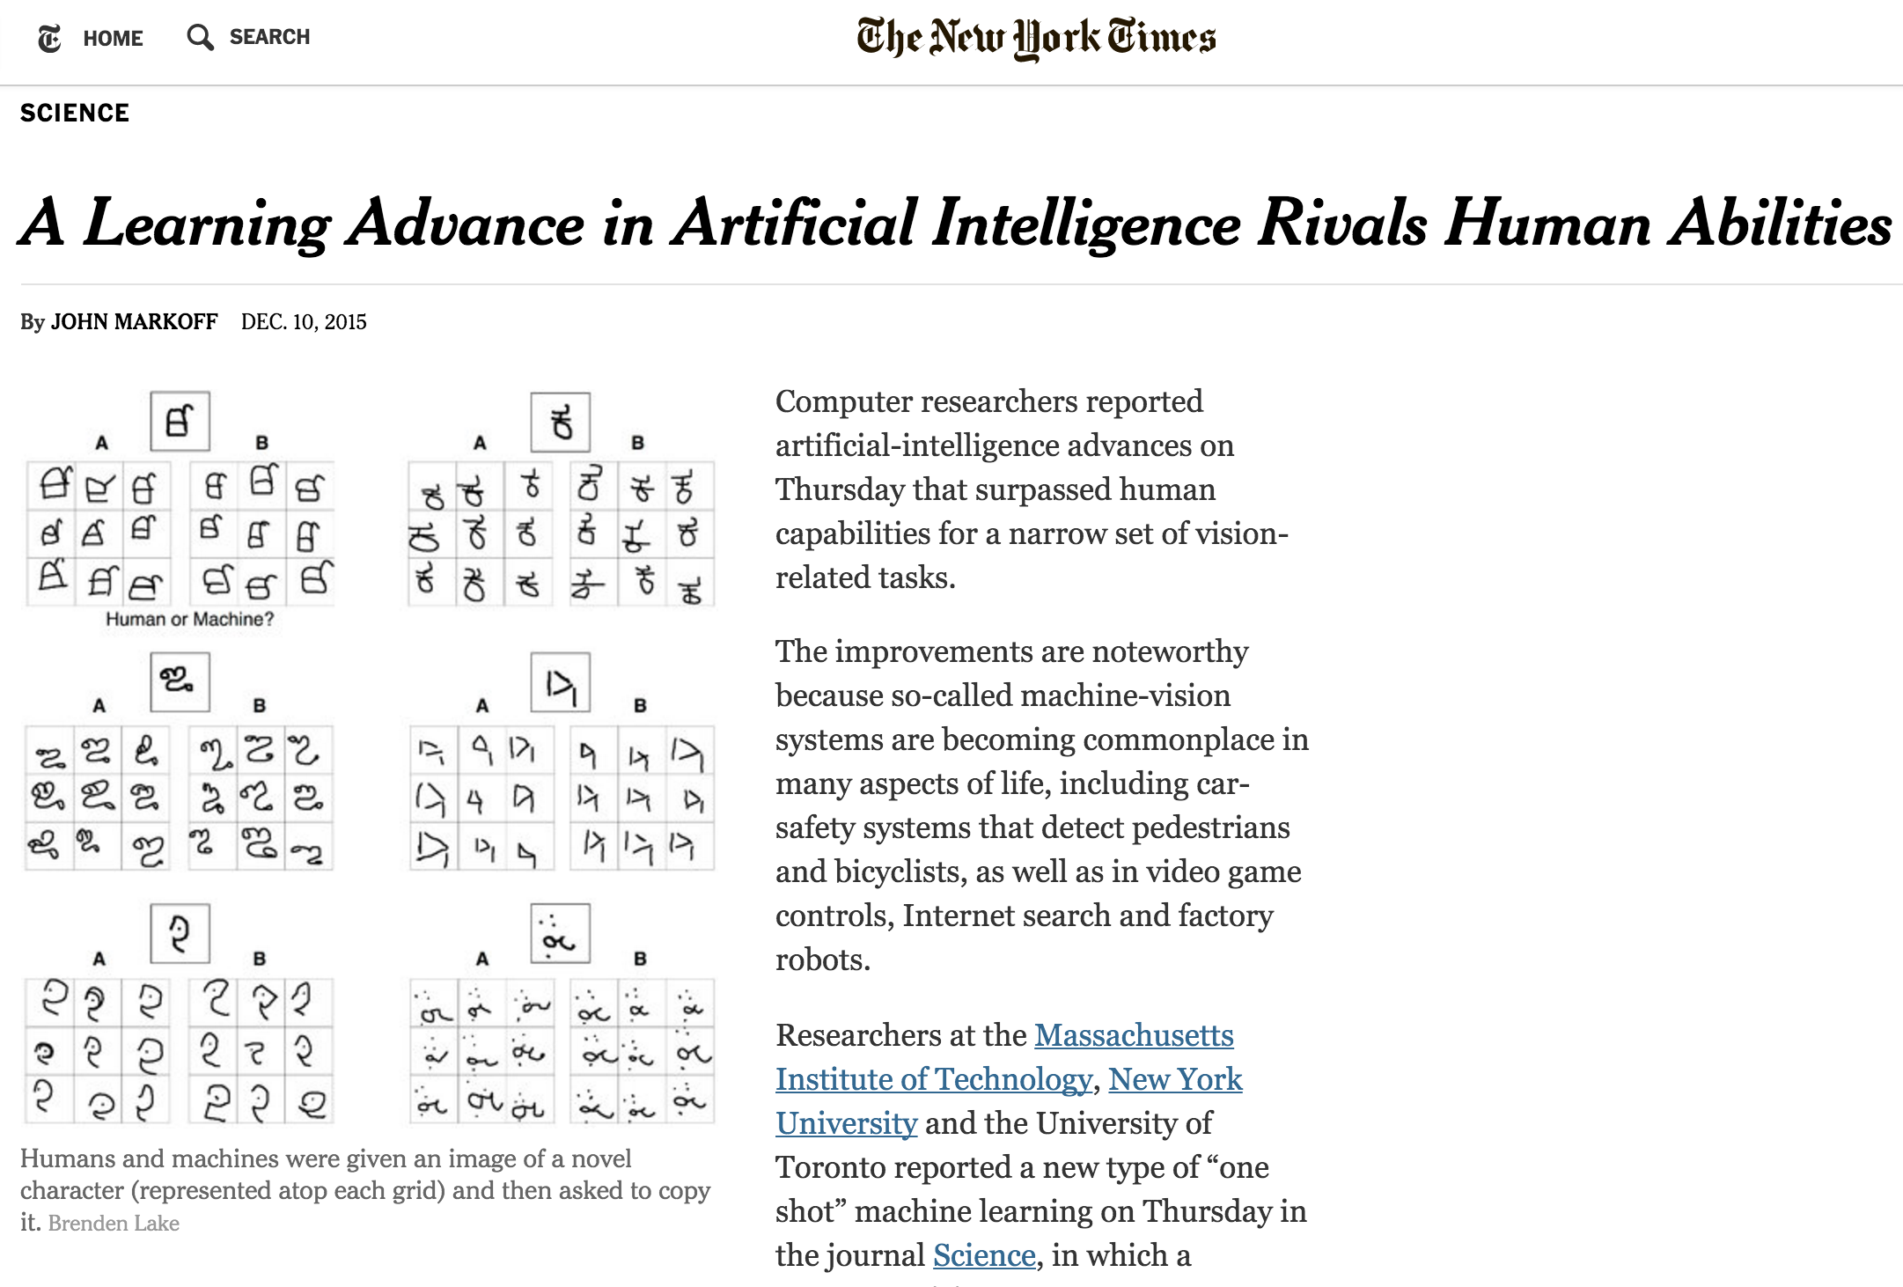


Slide 6
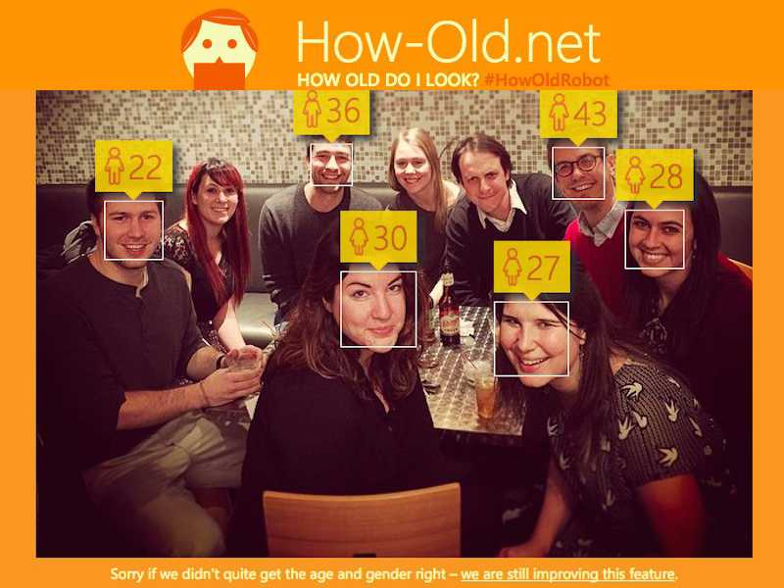

Slide 7
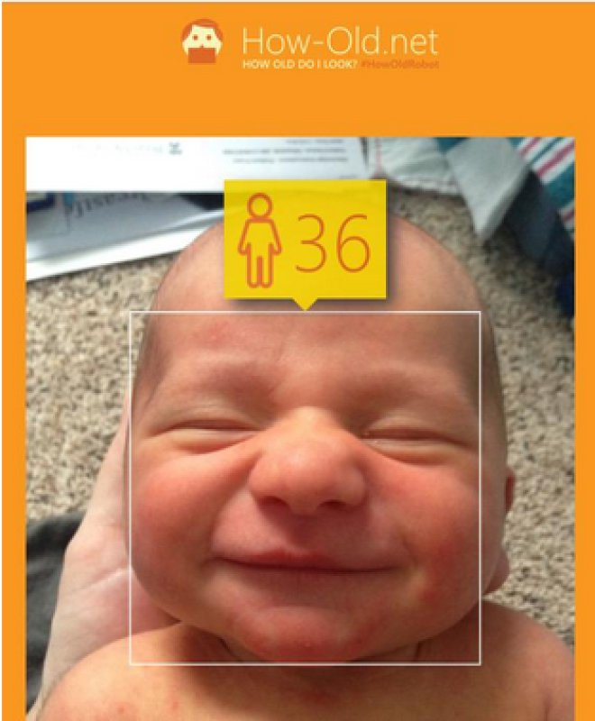

Slide 8
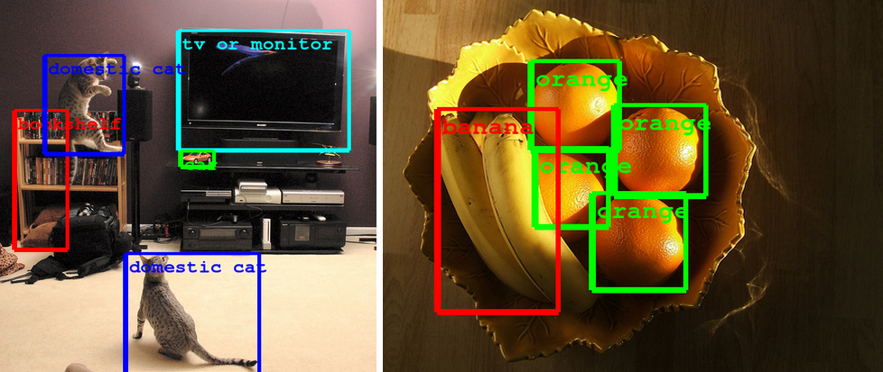
Source : http://googleresearch.blogspot.com/2014/09/building-deeper-understanding-of-images.html

Slide 9
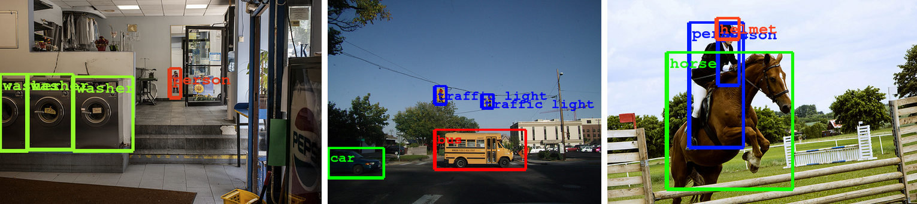
Source : http://googleresearch.blogspot.com/2014/09/building-deeper-understanding-of-images.html

Slide 10


Slide 11
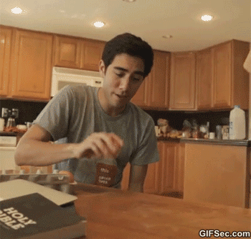

Slide 12
Convolution
Neural
Networks
(CNNs/ConvNets)

Slide 13
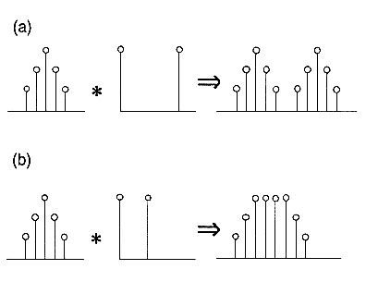
What is Convolution?
Mathematical Definition:
A function derived from two given functions by integration that expresses how the shape of one is modified by the other

Slide 14

Neural Networks
Notes:
Regular Neural Nets don't scale well to full images.

Slide 15
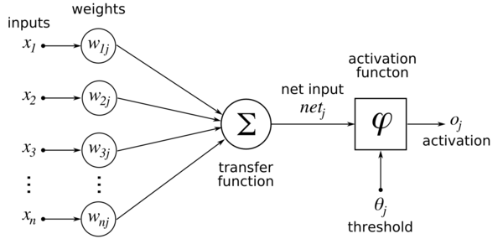
Neural Networks - Forward Pass

Slide 16
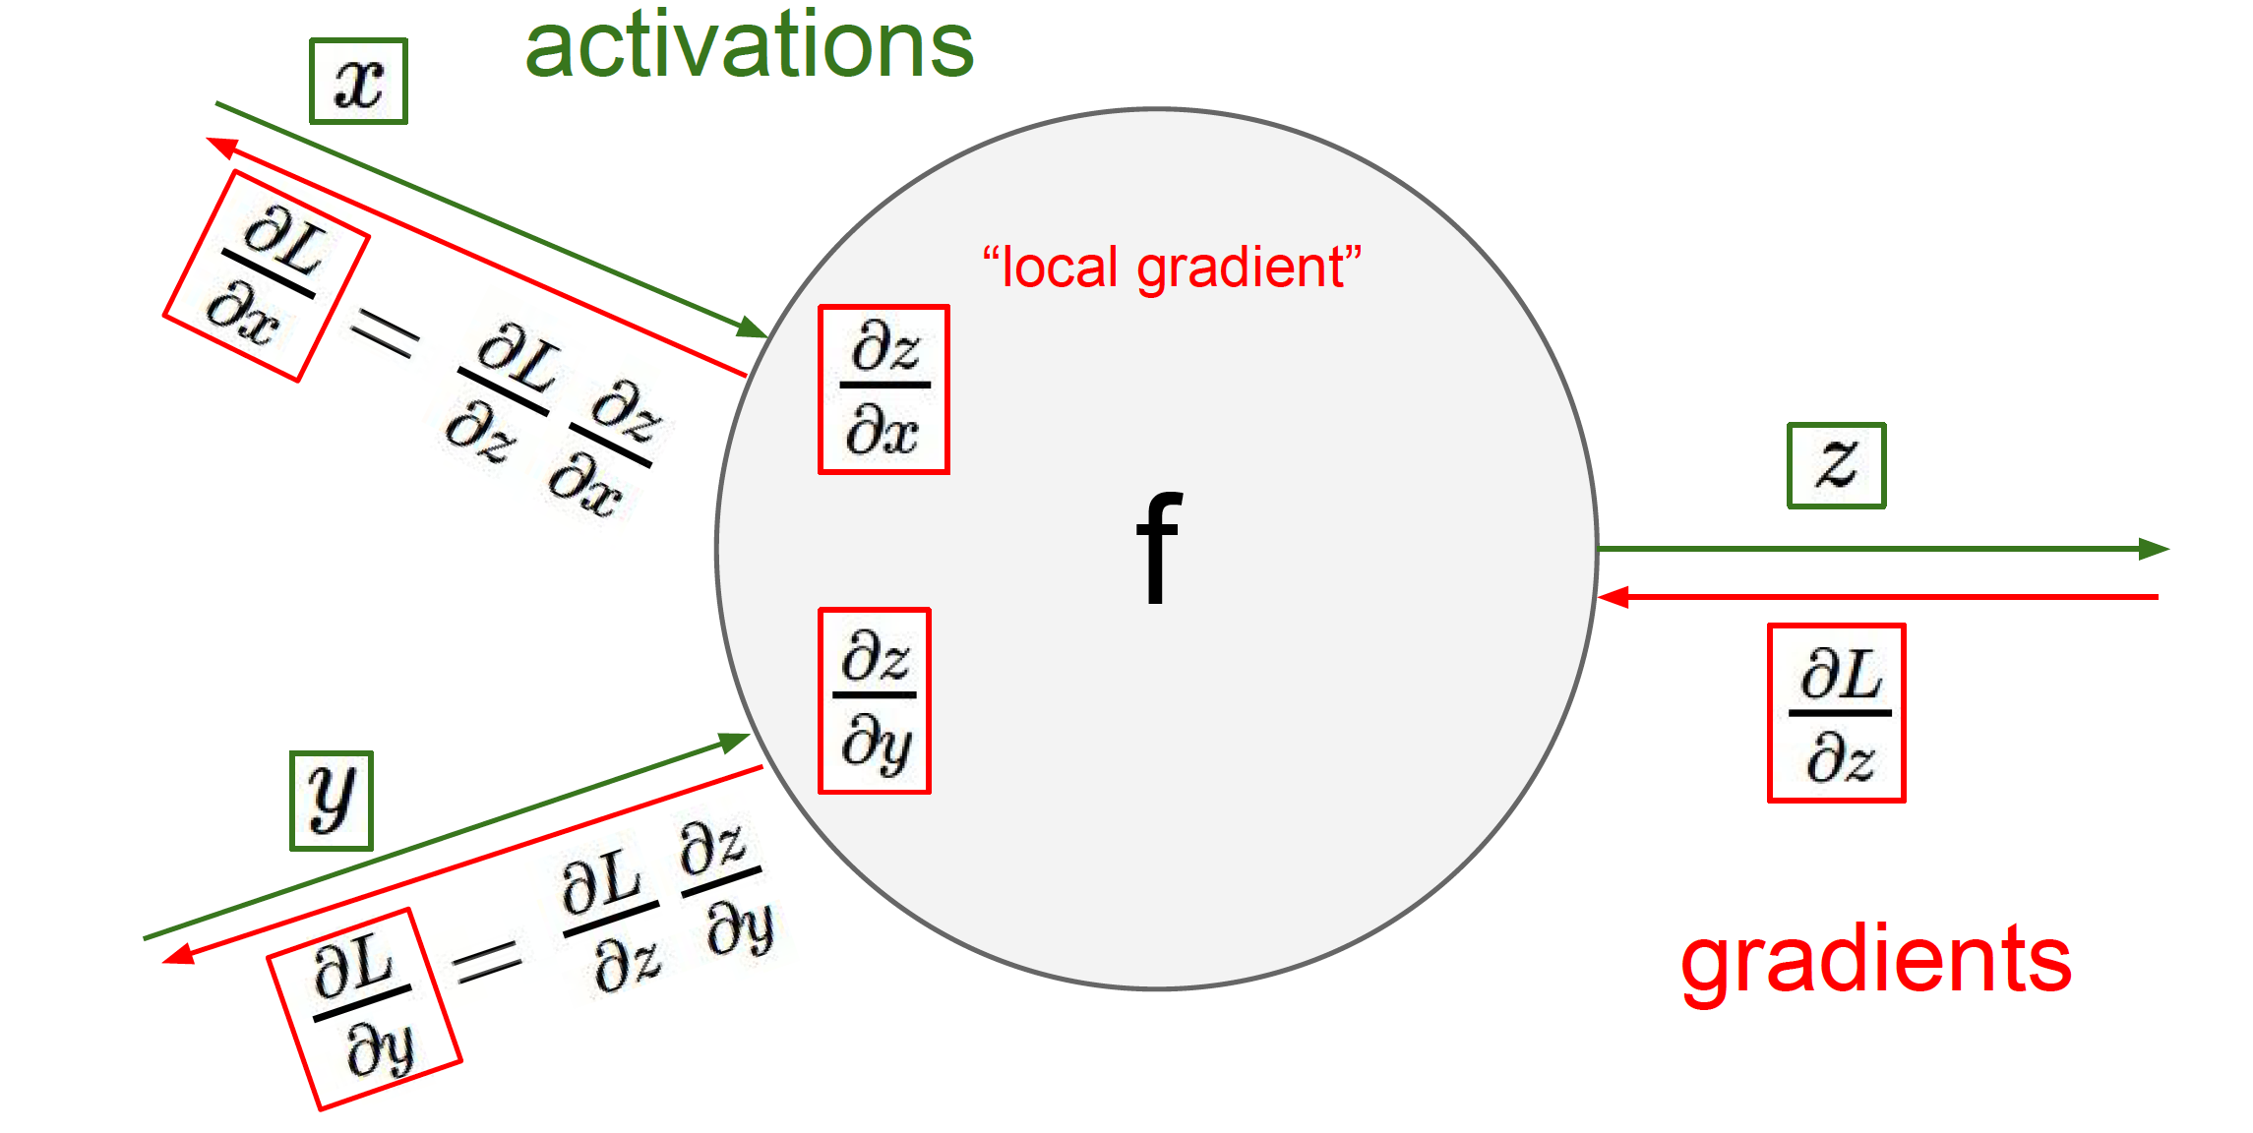
Neural Networks - Back Propagation
Source : http://cs231n.github.io

Slide 17
How CNN/ConvNets is different?
ConvNet architectures make the explicit assumption that the inputs are images, which allows us to encode certain properties into the architecture.
This assumption makes the forward function more efficient to implement and vastly reduces the amount of parameters in the network.

Slide 18
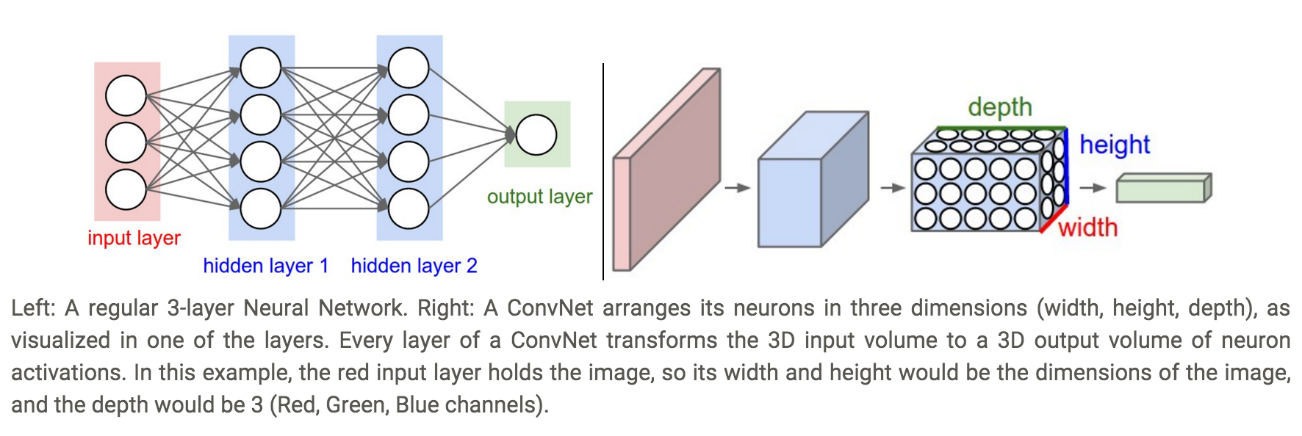
Cont. How CNN/ConvNets is different?
Source : http://cs231n.github.io/convolutional-networks

Slide 19
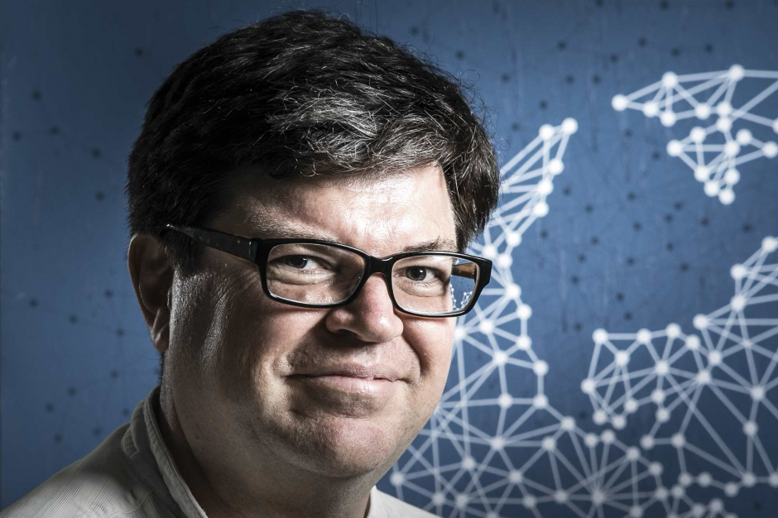
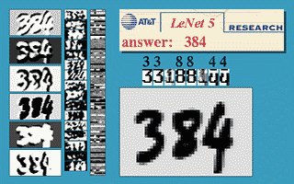
LeNet-5 1990
Yann LeCun
Director of AI Research at Facebook
Handwritten Digits Classification

Slide 20

LeNet-5 Architecture

Slide 21
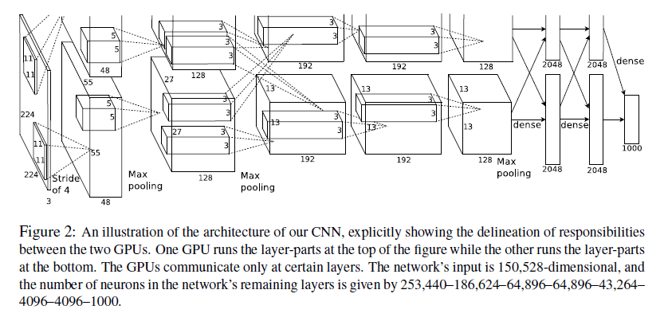
AlexNet Architecture - ImageNet 2012

Slide 22


Slide 23
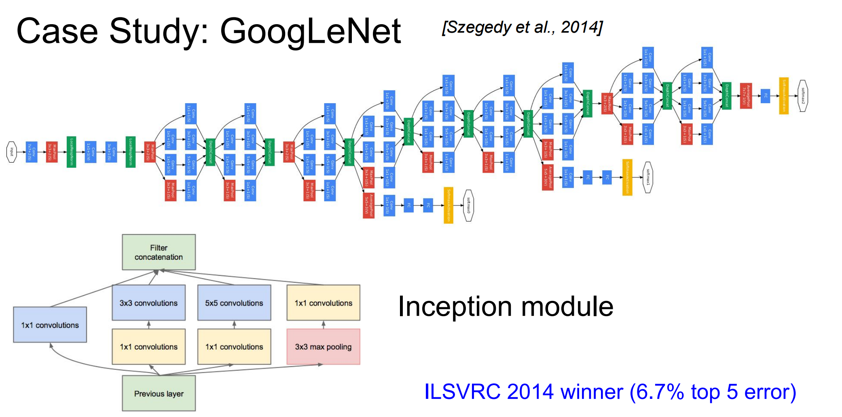

Slide 24
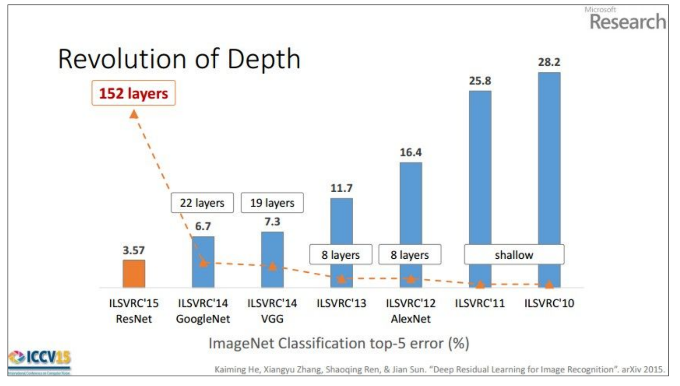

Slide 25
LeNet-5 Architecture

Slide 26
Layers in ConvNets
Convolution Layer
ReLU (Activation) Layer
Pooling Layer
Fully Connected Layer

Slide 27
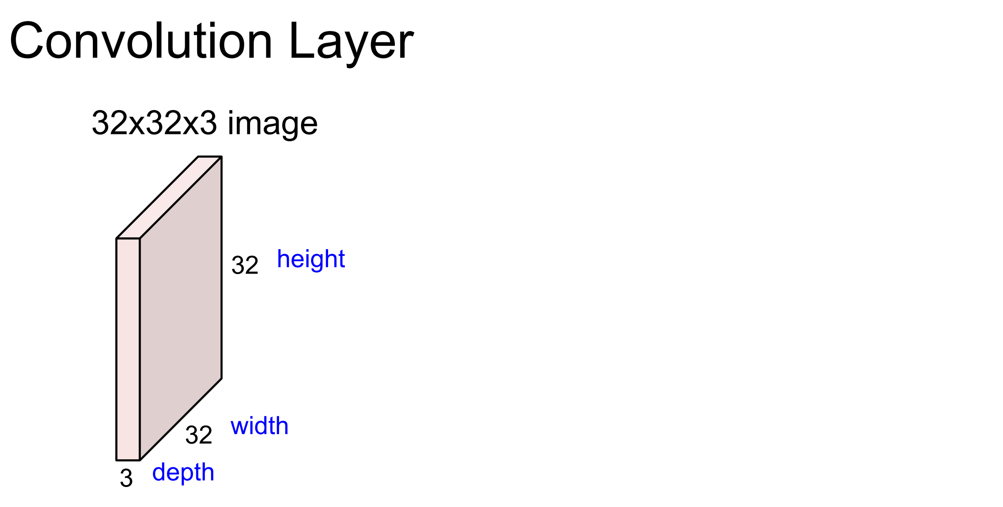
Source : http://cs231n.stanford.edu/slides/winter1516_lecture7.pdf

Slide 28
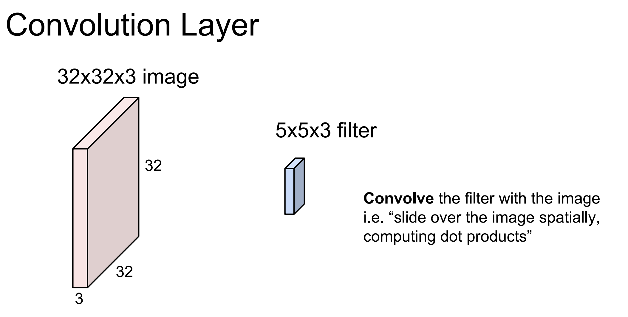
Source : http://cs231n.stanford.edu/slides/winter1516_lecture7.pdf

Slide 29
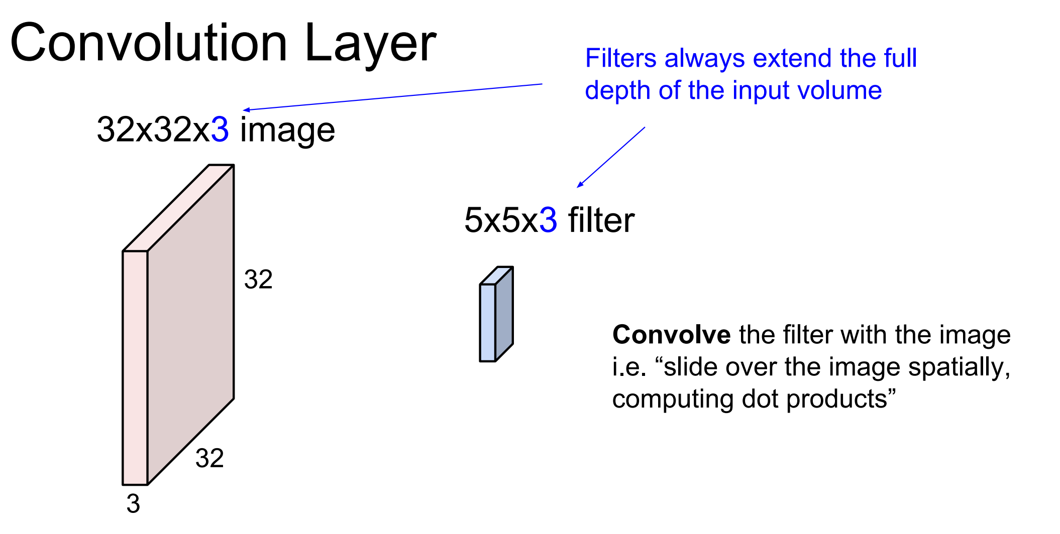
Source : http://cs231n.stanford.edu/slides/winter1516_lecture7.pdf

Slide 30
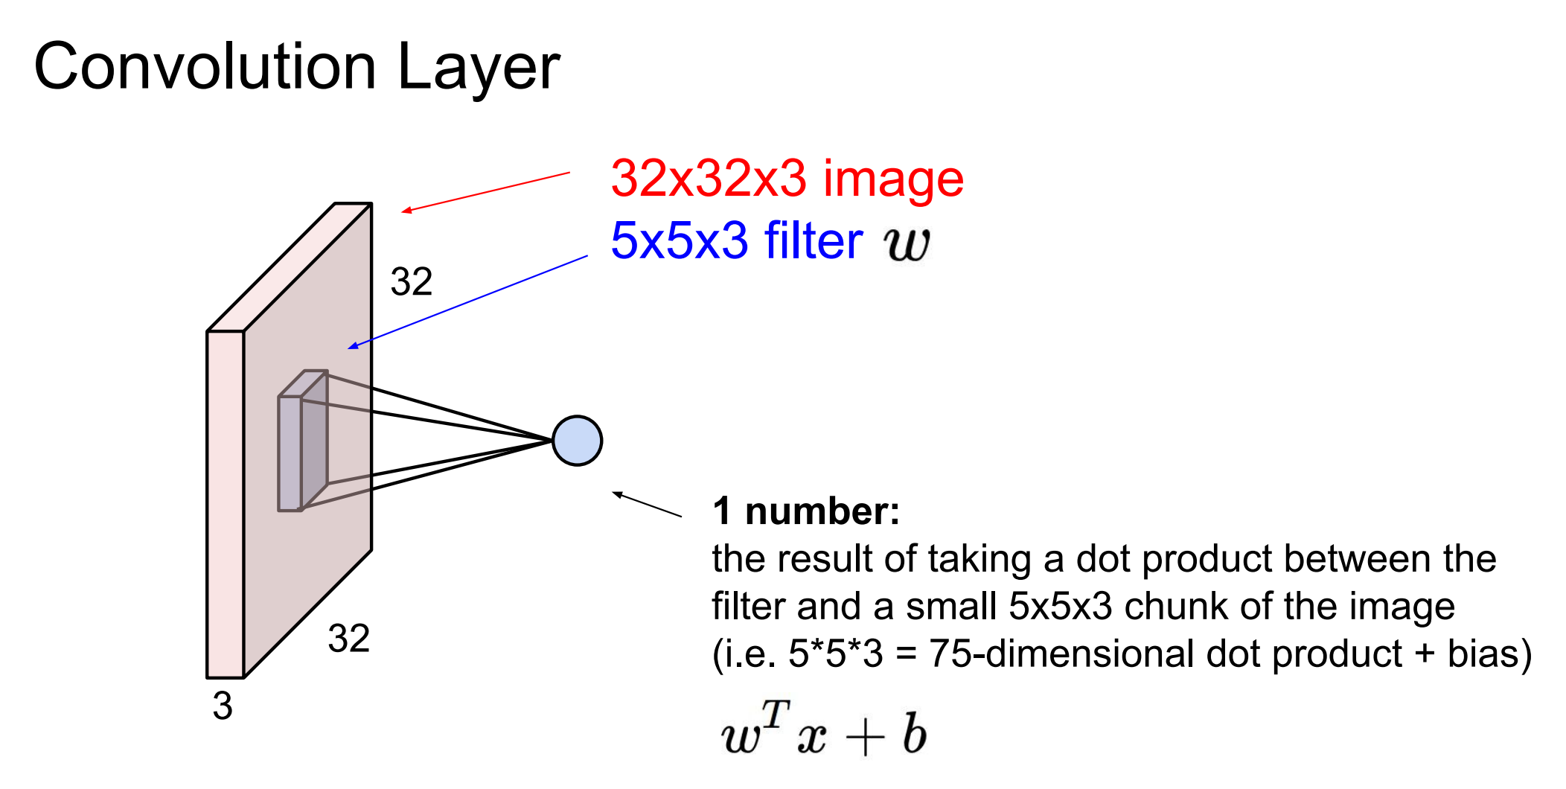
Source : http://cs231n.stanford.edu/slides/winter1516_lecture7.pdf

Slide 31


Slide 32
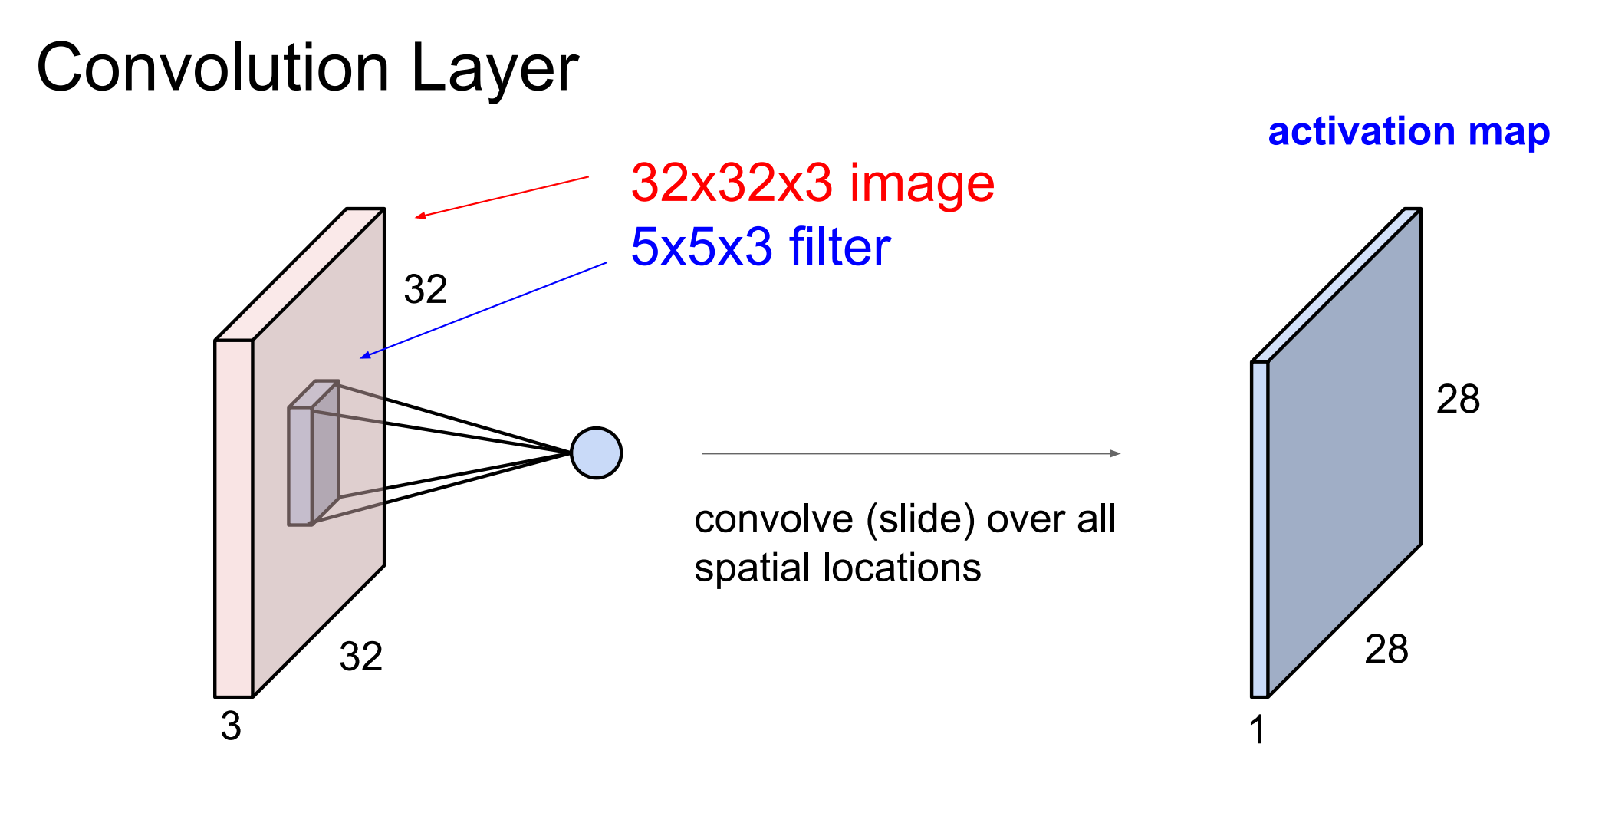
Source : http://cs231n.stanford.edu/slides/winter1516_lecture7.pdf

Slide 33
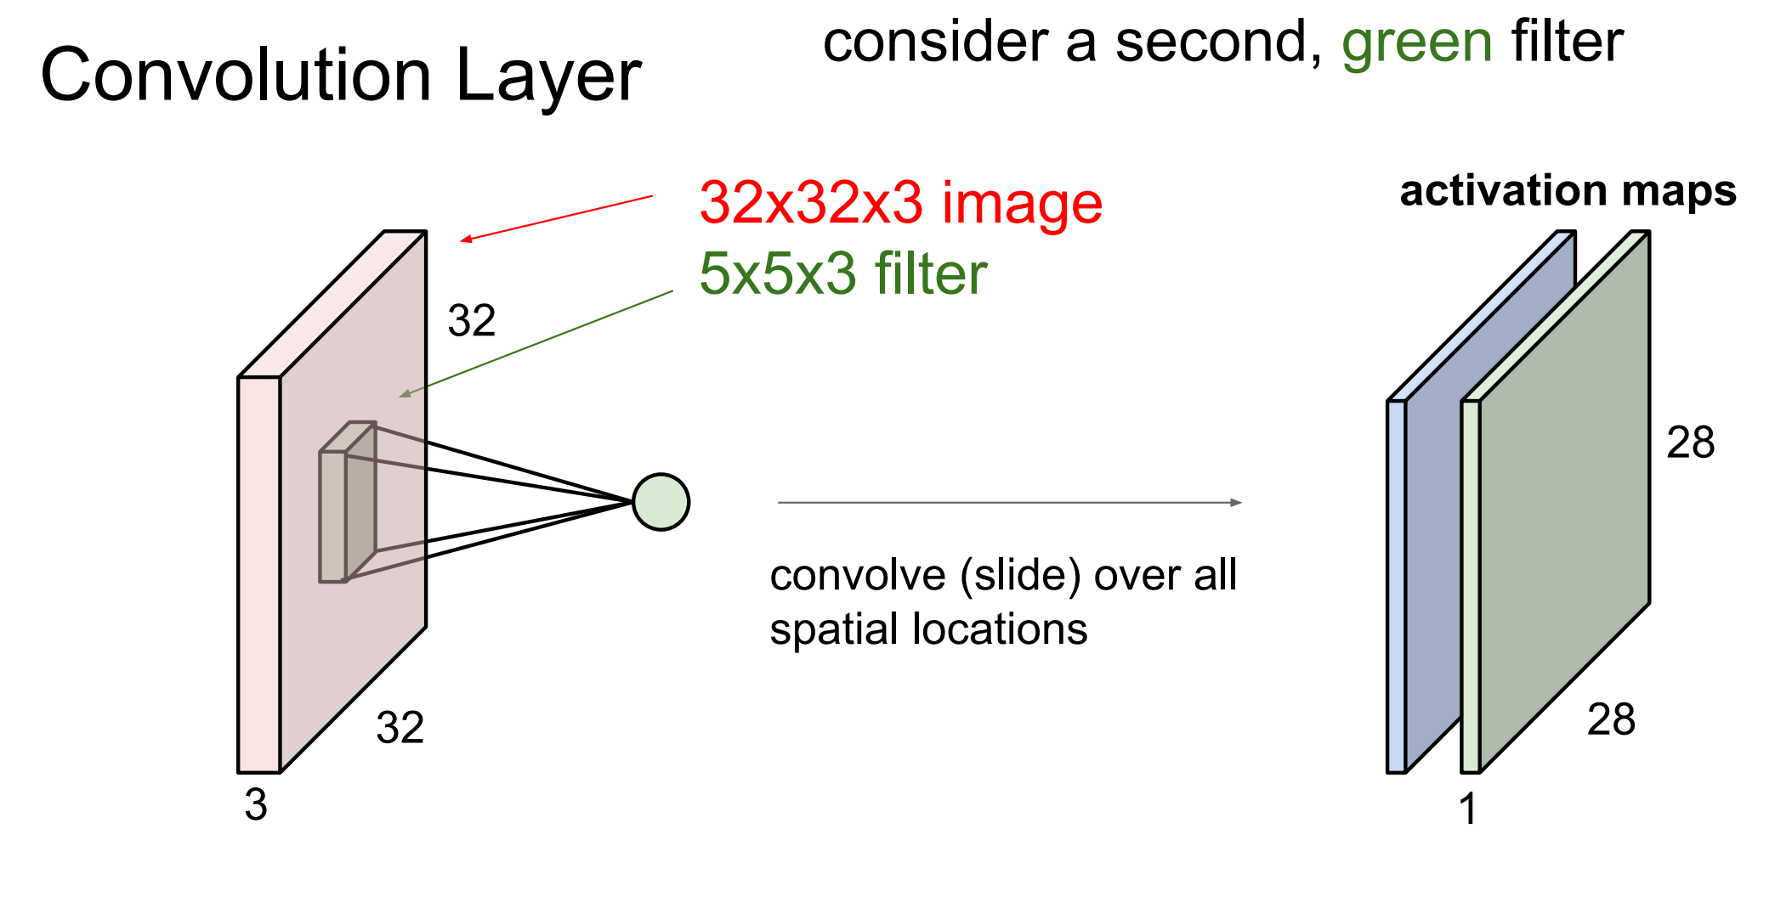
Source : http://cs231n.stanford.edu/slides/winter1516_lecture7.pdf

Slide 34
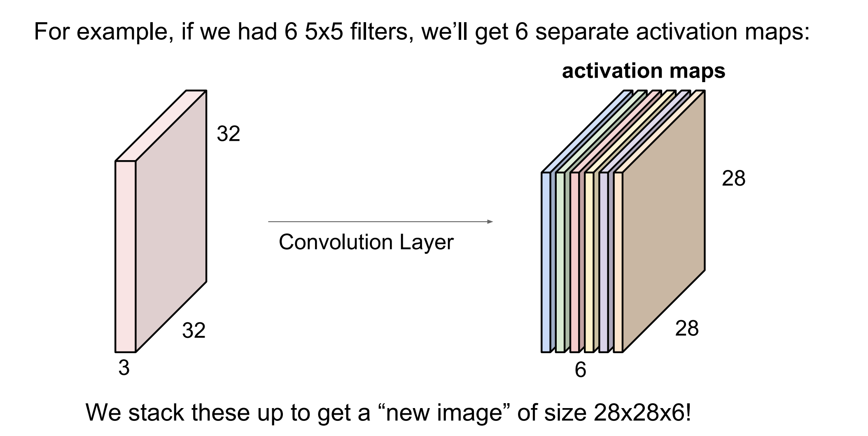
Convolution Layer
Source : http://cs231n.stanford.edu/slides/winter1516_lecture7.pdf

Slide 35
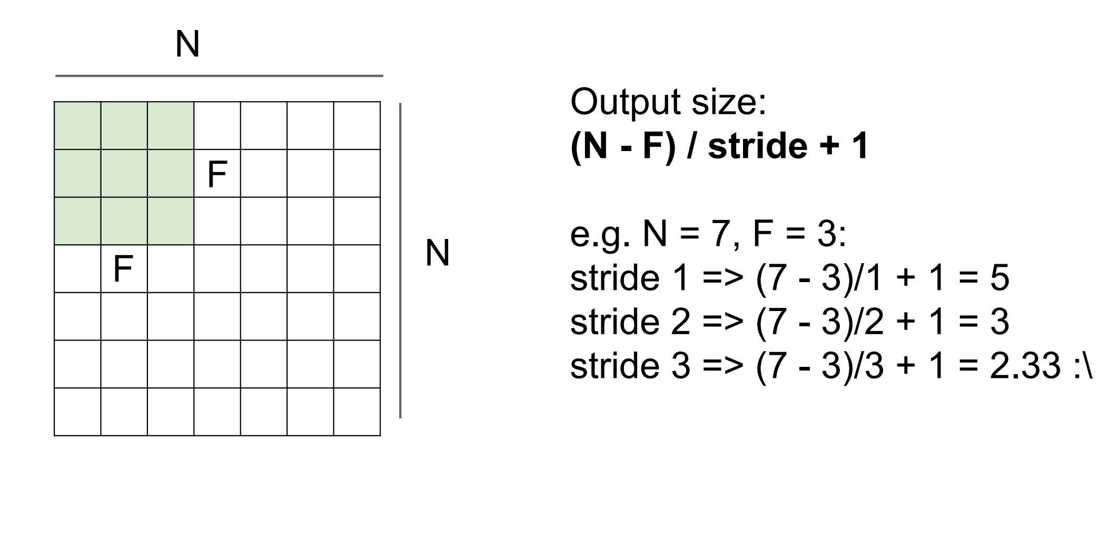
Convolution Layer
Source : http://cs231n.stanford.edu/slides/winter1516_lecture7.pdf

Slide 36
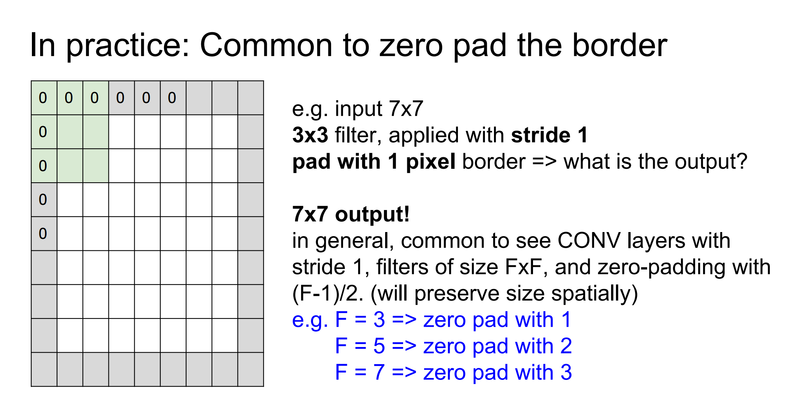
Convolution Layer
Source : http://cs231n.stanford.edu/slides/winter1516_lecture7.pdf

Slide 37
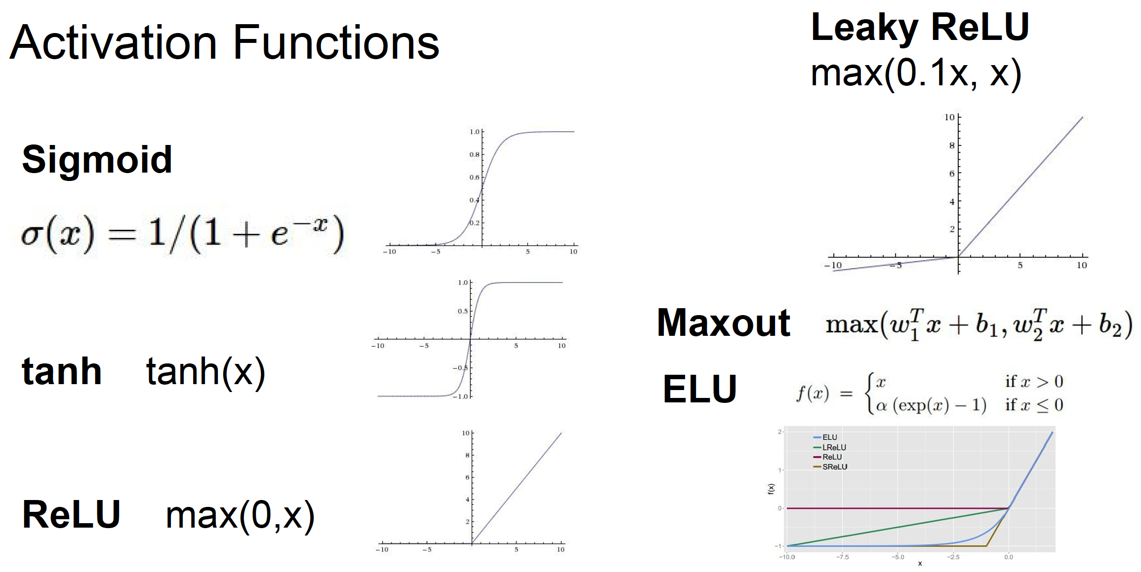
Activation Layer
Source : http://cs231n.stanford.edu/slides/

Slide 38
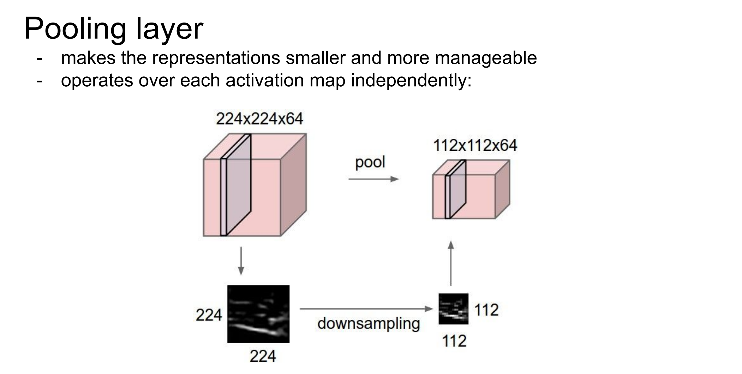
Source : http://cs231n.stanford.edu/slides/winter1516_lecture7.pdf

Slide 39
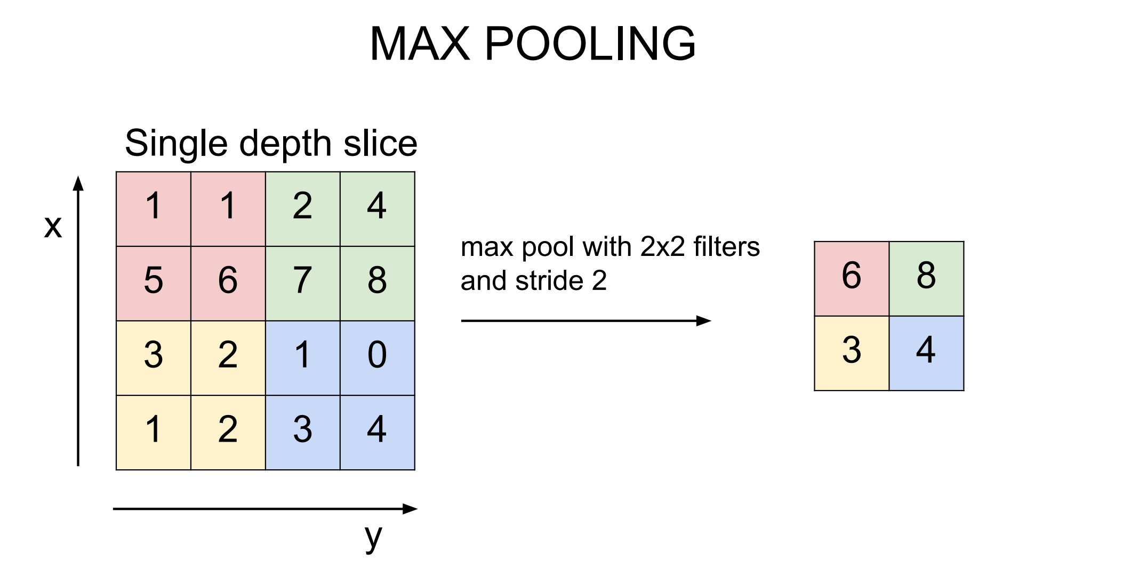
Pooling Layer
Source : http://cs231n.stanford.edu/slides/winter1516_lecture7.pdf

Slide 40
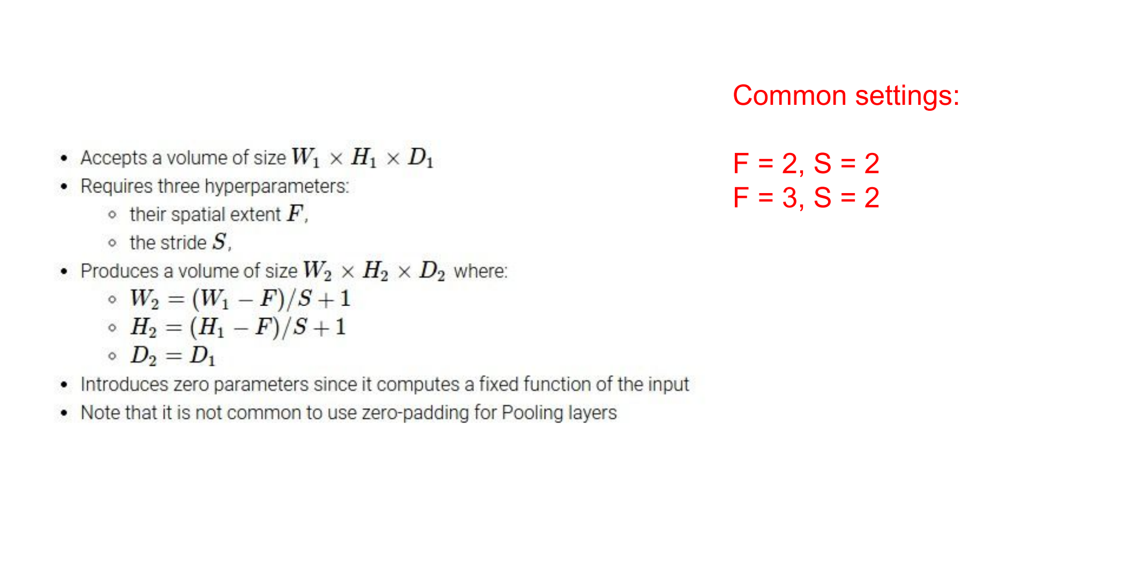
Pooling Layer
Source : http://cs231n.stanford.edu/slides/winter1516_lecture7.pdf

Slide 41
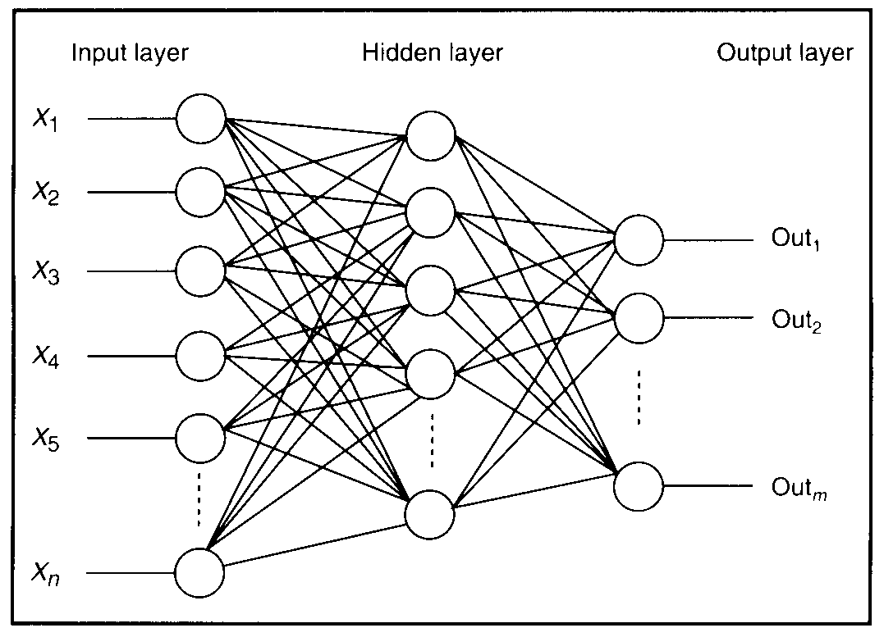
Fully Connected Layer

Slide 42


Slide 43
ConvNets Summary
A ConvNet architecture is a list of Layers that transform the image volume into an output volume (e.g. holding the class scores)
There are a few distinct types of Layers (e.g. CONV/FC/RELU/POOL are by far the most popular)
Each Layer accepts an input 3D volume and transforms it to an output 3D volume through a differentiable function
Each Layer may or may not have parameters (e.g. CONV/FC do, RELU/POOL don't)

Slide 44


Slide 45
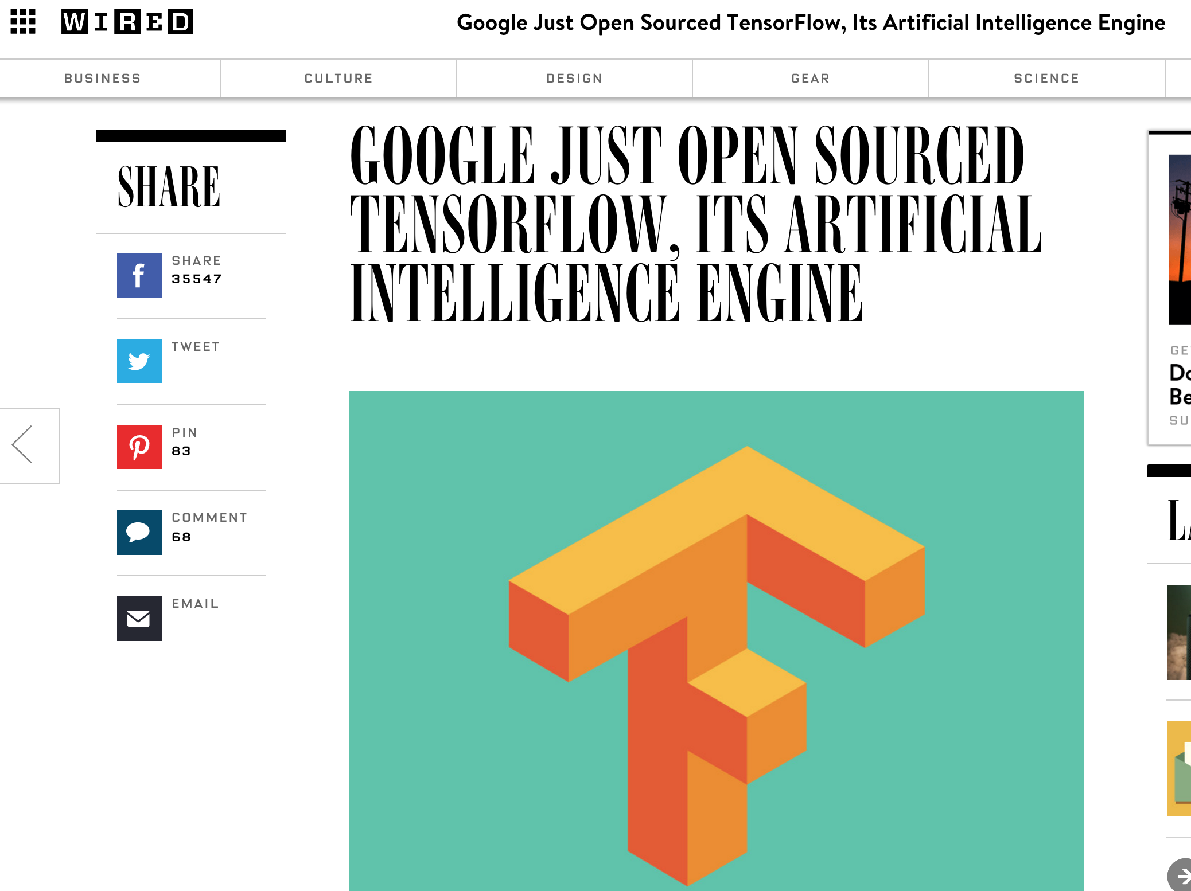

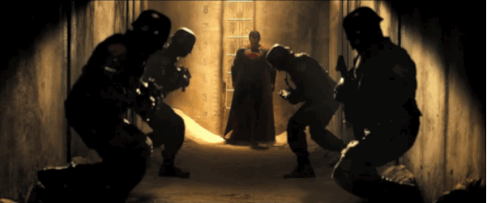

Slide 46
Google TensorFlow
Second generation Machine Learning system, followed by DistBelief
TensorFlow grew out of a project at Google, called Google Brain, aimed at applying various kinds of neural network machine learning to products and services across the company.
An open source software library for numerical computation using data flow graphs
Used in following projects at Google
DeepDream
RankBrain
Smart Reply
And many more..

Slide 47

Data Flow Graph
Data flow graphs describe mathematical computation with a directed graph of nodes & edges
Nodes in the graph represent mathematical operations.
Edges represent the multidimensional data arrays (tensors) communicated between them.
Edges describe the input/output relationships between nodes.
The flow of tensors through the graph is where TensorFlow gets its name.

Slide 48
Google TensorFlow Basic Elements
Tensor
Variable
Operation
Session
Placeholder
TensorBoard

Slide 49
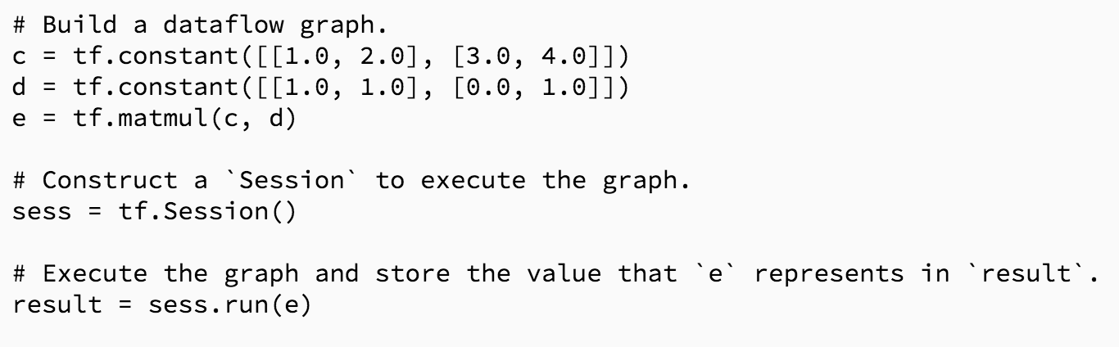
Tensor
TensorFlow programs use a tensor data structure to represent all data
Think of a TensorFlow tensor as an n-dimensional array or list
In the following example, c, d and e are symbolic Tensor Objects, where as result is a numpy array

Slide 50
Tensor Types
Constant Value Tensors
Sequences
Random Tensors

Slide 51
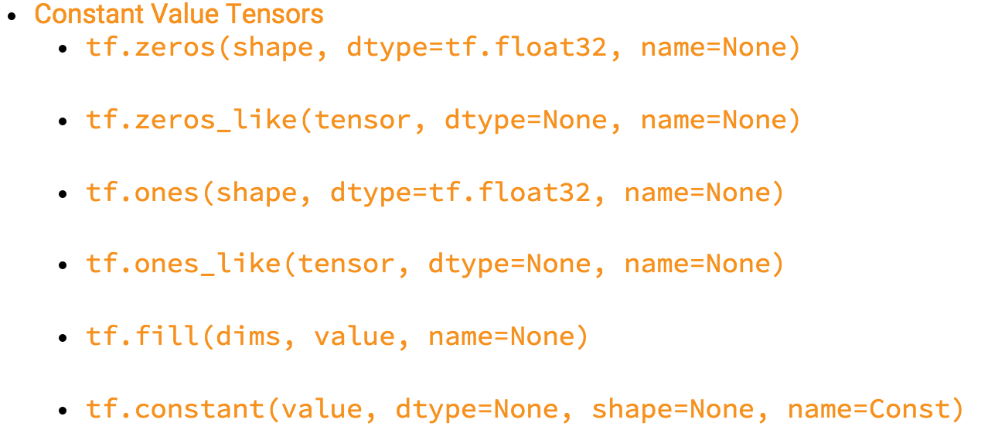
Constant Value Tensors

Slide 52
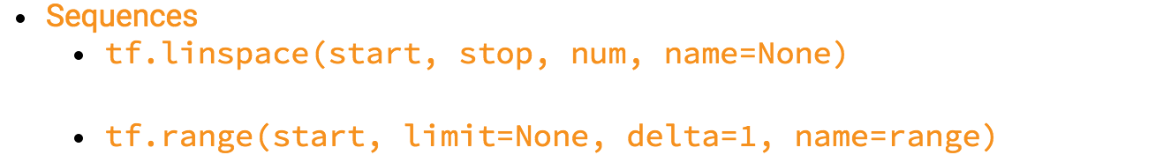
Sequence Tensors

Slide 53
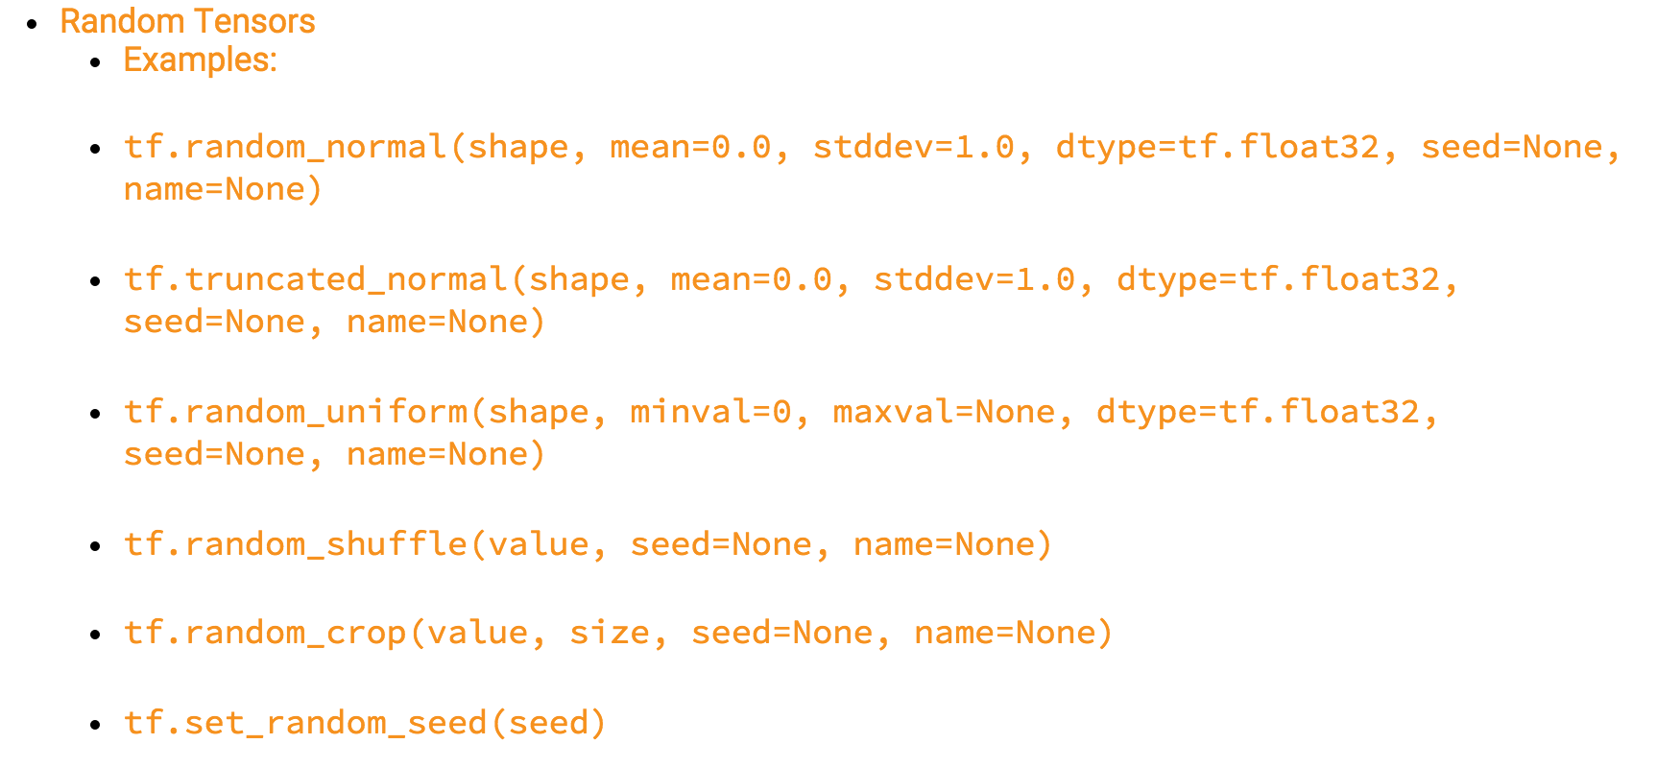
Random Tensors

Slide 54
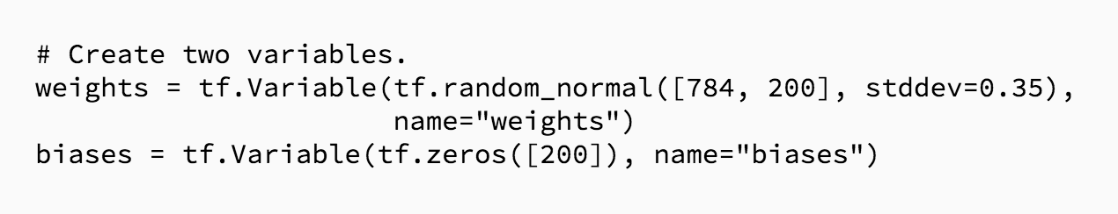
Variable
In-memory buffers containing tensors
Initial value defines the type and shape of the variable.
They must be explicitly initialized and can be saved to disk during and after training.

Slide 55
Operation
An Operation is a node in a TensorFlow Graph
Takes zero or more Tensor objects as input, and produces zero or more Tensor objects as output.
Example:
c = tf.matmul(a, b)
Creates an Operation of type "MatMul" that takes tensors a and b as input, and produces c as output.

Slide 56
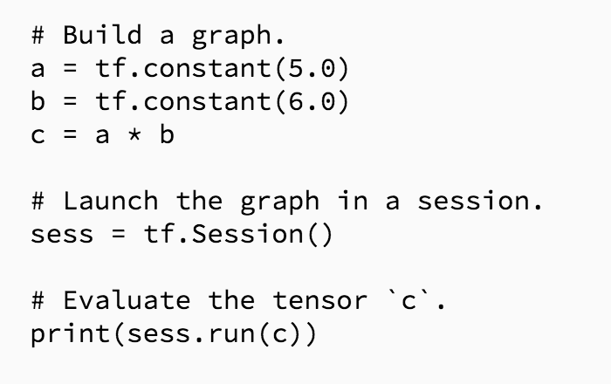
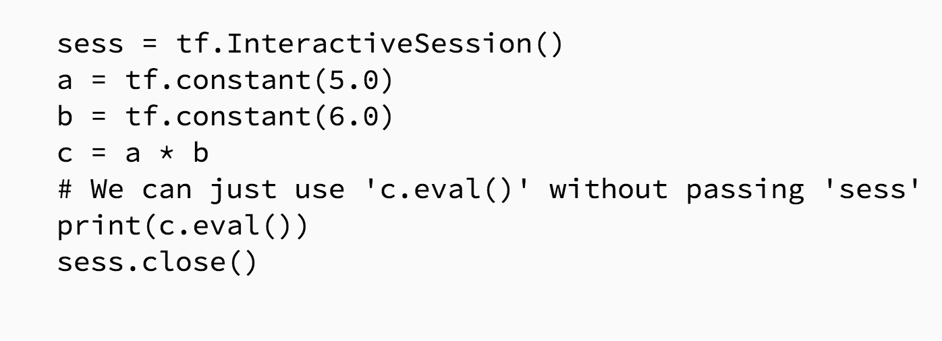
Session & Interactive Session
A class for running TensorFlow operations
InteractiveSession is a TensorFlow Session for use in interactive contexts, such as a shell and Ipython notebook.

Slide 57
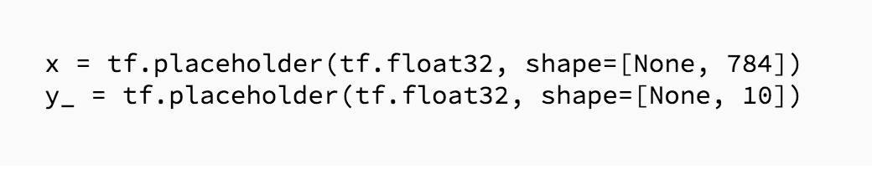
Placeholder
A value that we'll input when we ask TensorFlow to run a computation.

Slide 58
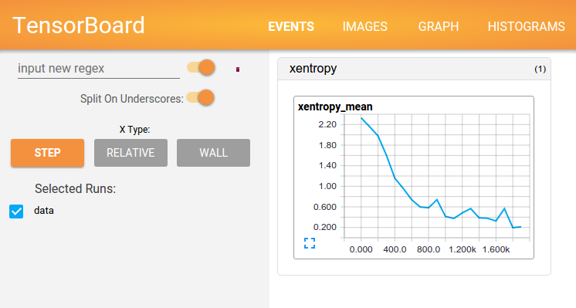
TensorBoard : Visual Learning

Slide 59
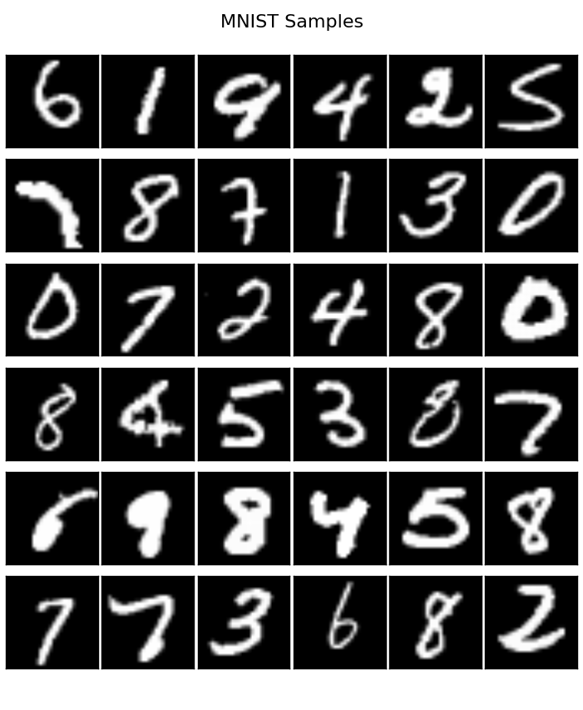
MNIST Dataset

Slide 60
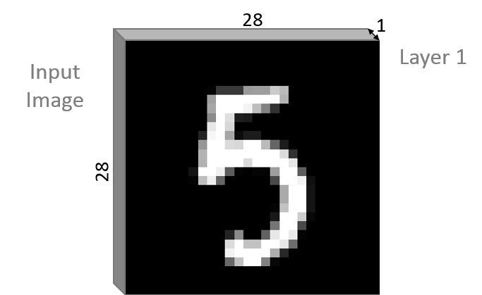
MNIST Dataset

Slide 61
LeNet-5 Architecture

Slide 62
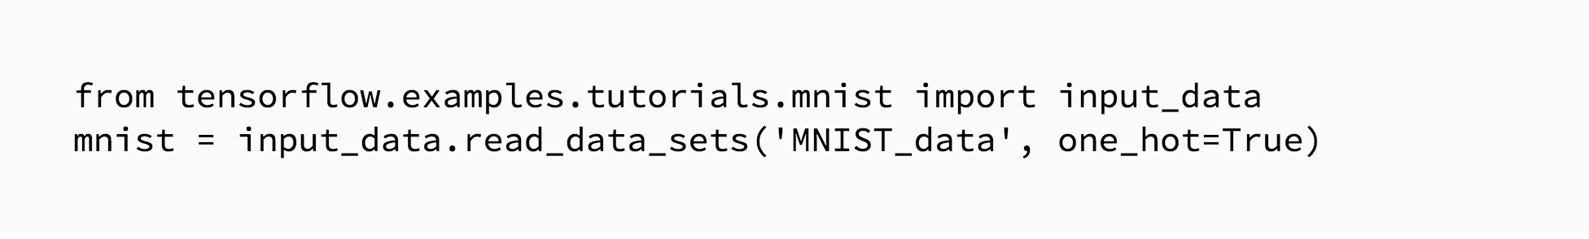
Load MNIST Data

Slide 63
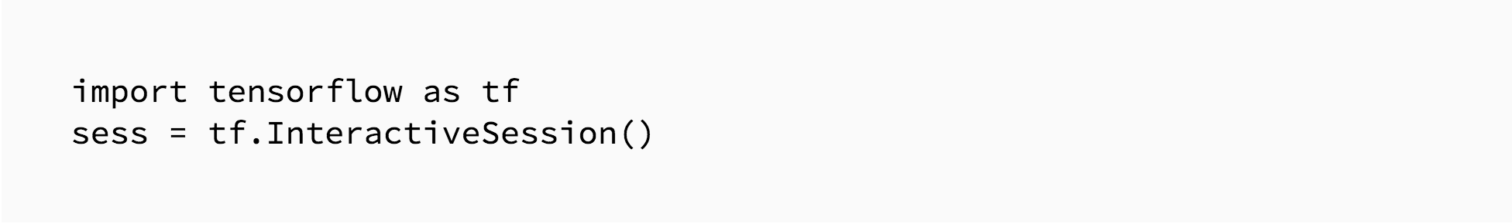
Load MNIST Data
Start a session

Slide 64
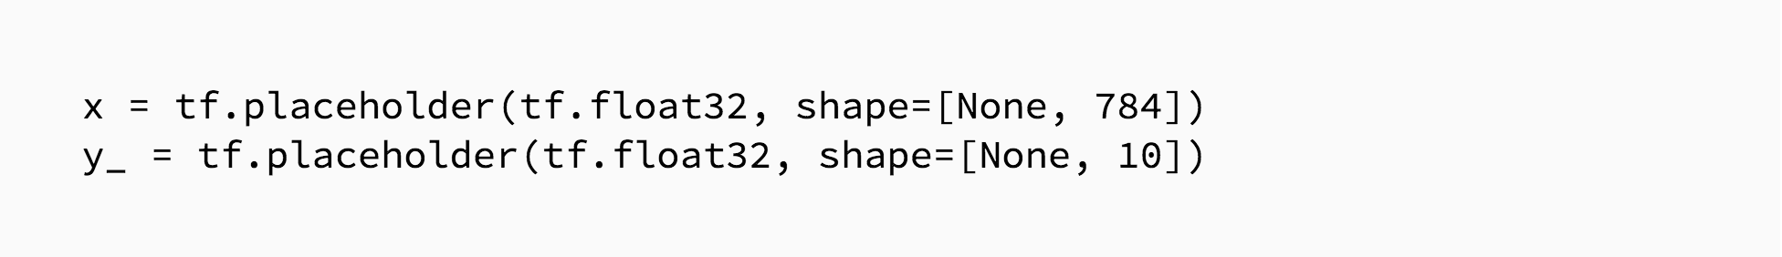
Dynamic Size
Placeholders

Slide 65
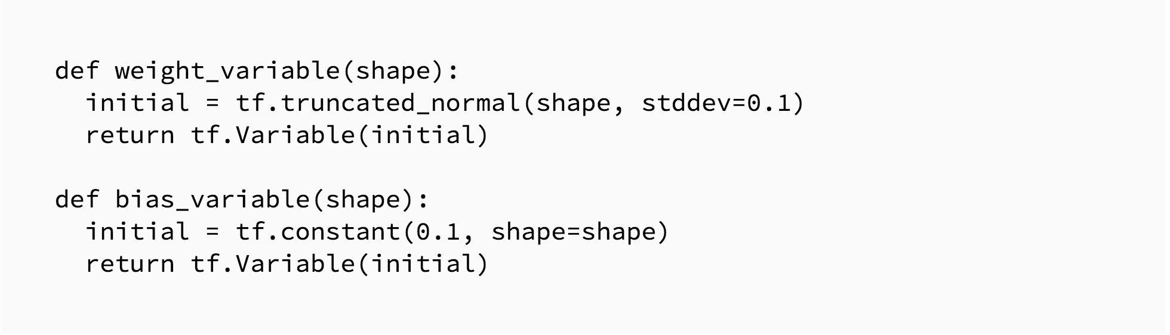
Placeholders
Weight/Filter & Bias

Slide 66
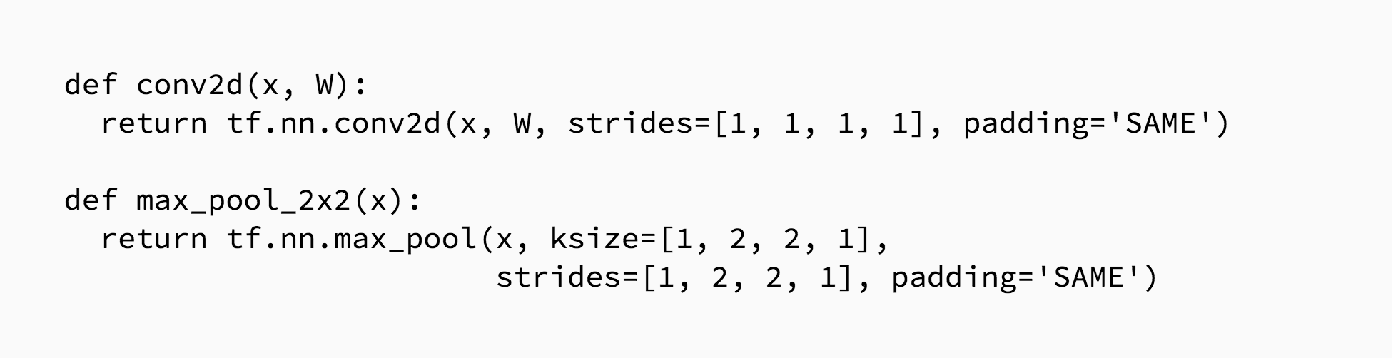
Convolution and Pooling
Stride of one
Max Pooling over 2x2 blocks
Stride of two

Slide 67
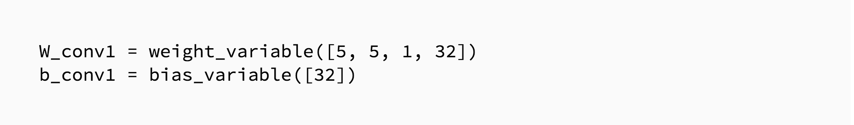
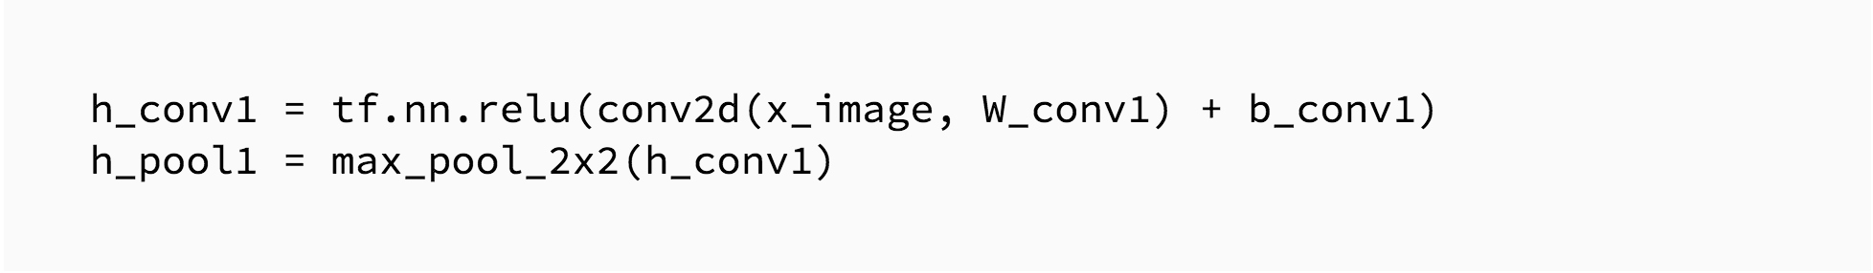
First Convolution Layer including ReLU
Filter/Patch Dimension
It will consist of convolution, followed by max pooling
Number of Output Channel
Number of Input Channels
Number of Output Channel

Slide 68

Second Convolution Layer including ReLU
It will consist of convolution, followed by max pooling

Slide 69

Fully Connected Layer
Reshape the tensor from the pooling layer into a batch of vectors
Multiply by a weight matrix, add a bias, and apply a ReLU

Slide 70

Dropout
To reduce over fitting, we will apply dropout before the readout layer.
Dropout is an extremely effective, simple and recently introduced regularization technique by Srivastava et al. in “Dropout: A Simple Way to Prevent Neural Networks from Overfitting” that complements the other methods (L1, L2, maxnorm).
Source : http://cs231n.github.io/neural-networks-2/

Slide 71

Dropout
We create a placeholder for the probability that a neuron's output is kept during dropout.
This allows us to turn dropout on during training, and turn it off during testing.
While training, dropout is implemented by only keeping a neuron active with some probability pp (a hyperparameter)

Slide 72

Readout Layer
Finally, we add a softmax layer, just like for the one layer softmax regression.

Slide 73

Optimizer
Train and Evaluate the Model
Loss Function
Accuracy
Training
Initialize
All
Variables
Testing

Slide 74
TensorBoard
TensorBoard operates by reading TensorFlow events files, which contain summary data that you can generate when running TensorFlow.

Slide 75
TensorBoard
TensorBoard operates by reading TensorFlow events files, which contain summary data that you can generate when running TensorFlow.
First, create the TensorFlow graph that we'd like to collect summary data from, and decide which nodes should be annotated with summary operation.
For example,
For MNIST digits CNNs, we'd like to record how the learning rate varies over time, and how the objective function is changing
We’d like to record distribution of gradients or weights

Slide 76

TensorBoard
Graph Representation
Graph Representation
Histogram Summary

Slide 77

TensorBoard

Slide 78

TensorBoard

Slide 79


Slide 80


